Slide 1
Lending Club
Case Study
By
M.Mangaiyarkarasi
Manthi Ramesh

Slide 2
Lending Club Case Study
Description :
This study is based on a consumer finance company which specializes in lending various types of loans to urban customers.
Company has to take decision to approve the loan application based on data of past loan applicants to reduce/avoid defaulters hence reduce the financial loses to the company.
Task :
Our aim is to study consumer attributes and loan attributes with the help of data from past loan applicants using EDA then identify patterns, which leads to a person is likely to default.

Slide 3
Libraries and data set used for case study :
Libraries: | Data set:
Numpy Pandas Matplotlib.pyplot Seaborn | Loan.csv Number of Rows in the Dataset= 39717 Number of Columns in the Dataset= 111
Data Cleaning and Manipulation :
After dropping null values left out Rows = 39717, Columns = 57
After removing single valued columns, which are not useful for analysis remaining Rows = 39717, Columns = 48
Columns such as id, member_id, url, zip_code, last_credit_pull_d, and desc do not contribute to loan risk analysis. Hence, removed these columns from the dataset.
Columns with more than 60% missing values cannot be imputed without introducing bias into our analysis. Therefore, removed these columns.
Final shape of the data set is 39717 rows and 27 columns.

Slide 4
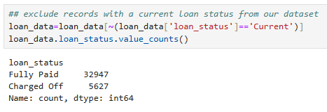
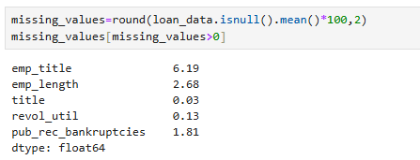
Filtering Loan Status for Analysis:
The objective of this analysis is to determine the likelihood of loan default. This can only be assessed for loans that are either fully paid or charged off. Current loans cannot provide meaningful insights into default risk. Therefore, we excluded records with a current loan status from our dataset.
Checking and Imputing Missing Values:
To ensure the quality of our data, we need to identify and handle missing values appropriately.
Imputing missing values helps maintain the integrity of the dataset without introducing bias.
Imputed missing values with Mode to maintain integrity of data set.

Slide 5
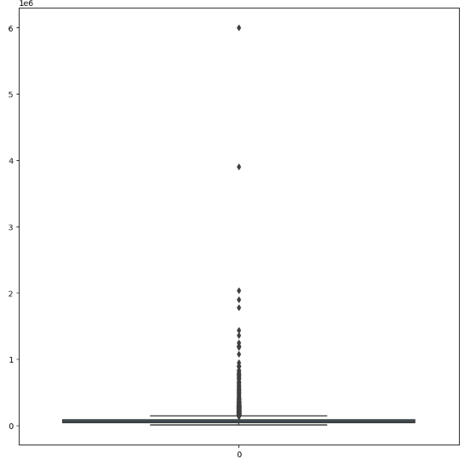
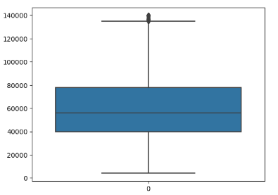
Outlier Detection and Removal Using Boxplots :
Annual Income Box Plot at 100%
Annual Income Box Plot at 95% quantile

Slide 6
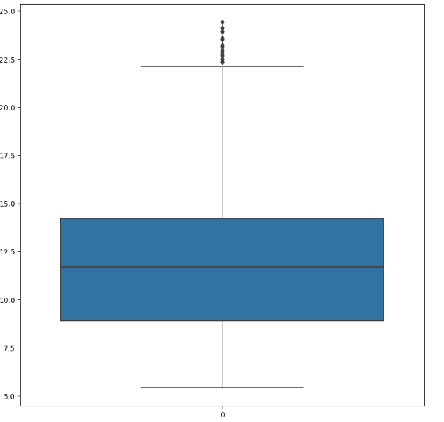
Interest Rate Box Plot

Slide 7
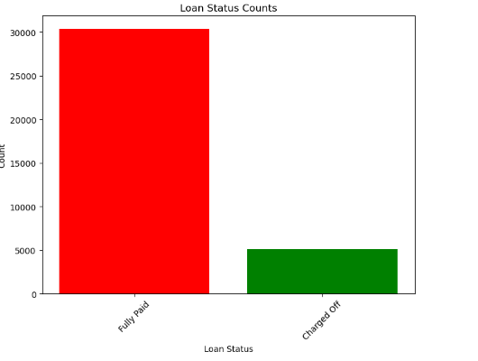
Bar Plot of Loan Status
85.5%
Percentage of customers fully paid =85.5
Percentage of customers Charged off =14.5
14.5%

Slide 8
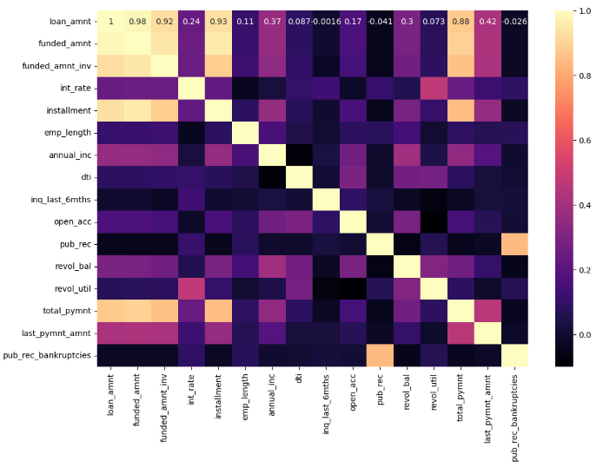
Heat Map

Slide 9
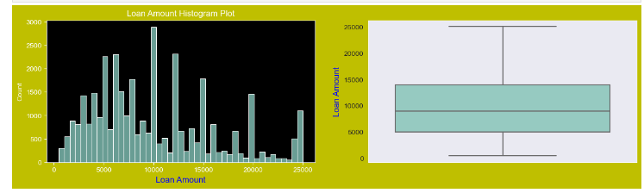
Univariate Analysis
Loan Amount Histogram and Box Plot
Observations : The majority of loan amounts fall within the range of 5000 to 15000

Slide 10
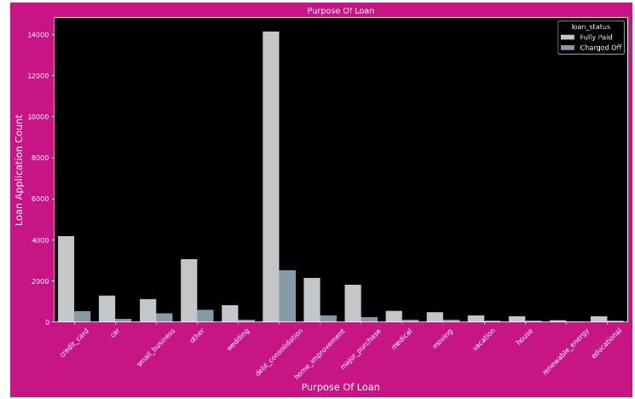
Histogram Plot for Purpose of Loan
Observations :
The count plot shows that debt consolidation accounted for the majority of loans taken out. Furthermore, a very high number of loans that have been charged off are connected to these uses.

Slide 11
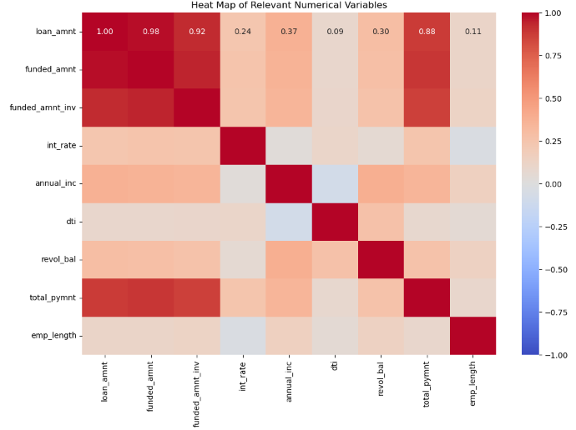
Bivariate Analysis
Heat Map

Slide 12
Observations
Loan amount, funding amount, and funded amount invested are strongly correlated: These three variables are closely related, indicating that as one increases, the others tend to increase as well.
Interest rate and employee length are negatively correlated: This suggests that longer employee tenure is associated with lower interest rates, possibly reflecting lower risk for long-term employed individuals.
Delinquency in the past 2 years and inquiries in the last 6 months are positively correlated with the interest rate: This suggests a tendency towards higher interest rates for borrowers with recent delinquencies and numerous recent credit inquiries, indicating a higher risk of default.
Annual income is positively correlated with loan amount, revol_bal, and total payment: Higher income individuals tend to take out larger loans, have higher revolving balances, and make higher total payments.
Debt-to-income (DTI) ratio is positively correlated with revolving balance: This indicates that individuals with higher revolving balances tend to have higher debt-to-income ratios.
Total payment is strongly correlated with loan amount, funded amount, and funded amount invested: This shows that larger loans lead to higher total payments over time.

Slide 13
Bi variate Analysis, Part One with loan status
In this section, we will compare the loan status to certain important columns that might have an impact on debts that have been charged off.
LOAN AMOUNT
INTEREST RATE
ANNUAL INCOME
PURPOSE OF LOAN
GRADE
SUB GRADE
EMP LENGTH (EMPLOYEE EXPERIENCE)
DTI
HOME OWNERSHIP
VERIFICATION STATUS
ADDRESS STATE
PUB_REC_BANKRUPTICIES (BANKRUPTICIES)

Slide 14
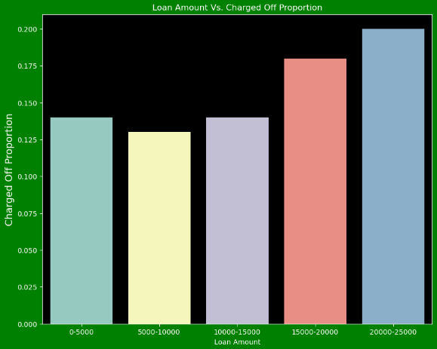
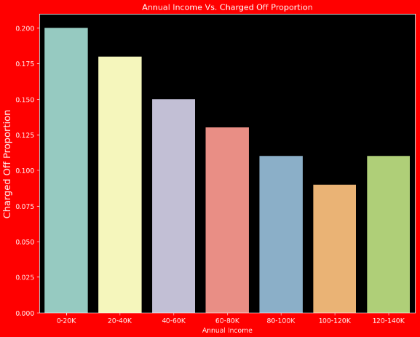
Bi variate Analysis, Part One with loan status
Loan Amount Vs Charged off Proportion
Annual Income Vs Charged off Proportion

Slide 15
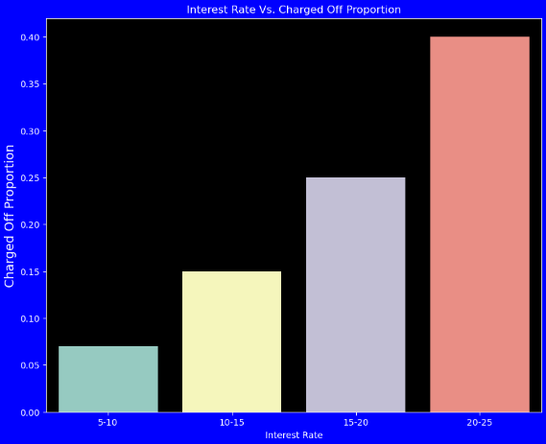
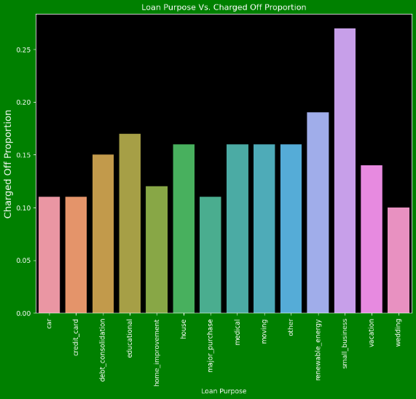
Bi variate Analysis, Part One with loan status
Interest Rate Vs Charged off Proportion
Loan Purpose Vs Charged off Proportion

Slide 16
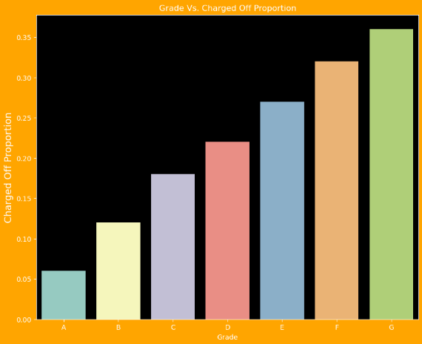
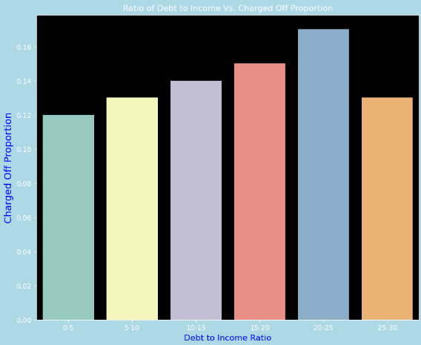
Bi variate Analysis, Part One with loan status
Grade Vs Charged off Proportion
Debt to Income Ratio Vs Charged off Proportion

Slide 17
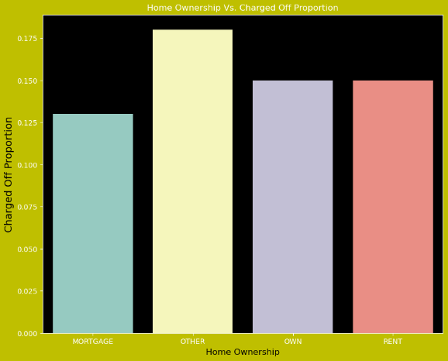
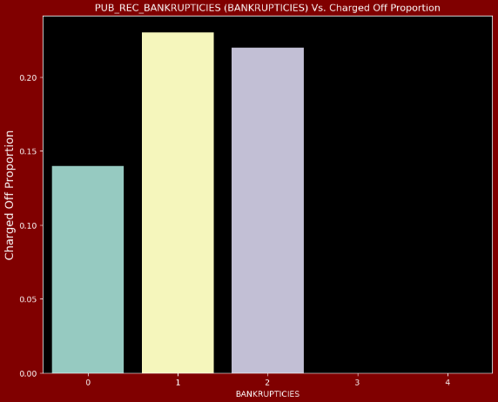
Bi variate Analysis, Part One with loan status
Home Ownership Vs Charged off Proportion
Bankruptcies Vs Charged off Proportion

Slide 18
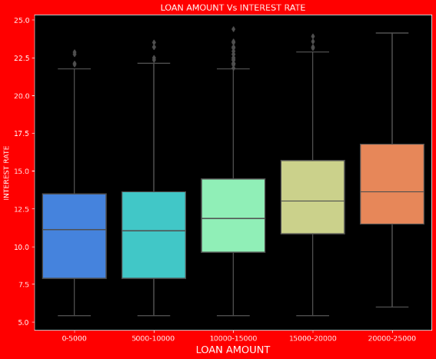
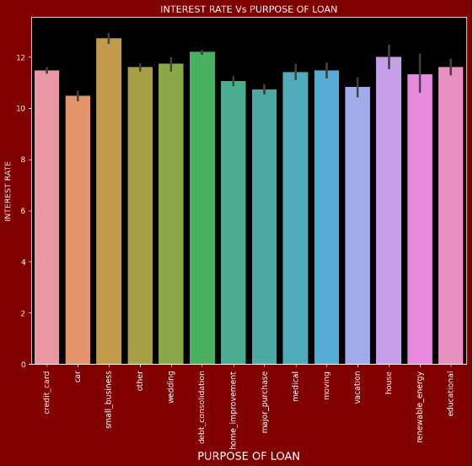
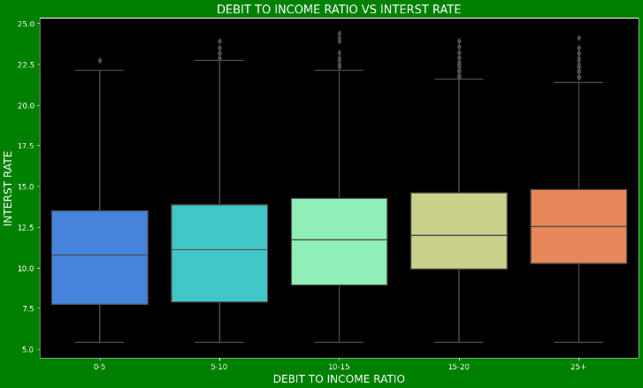
Bi variate Analysis with Two Different components, Part Two
Loan Amount Vs Rate of Interest
Loan Purpose Vs Rate of Interest
Debt to Income Vs Rate of Interest

Slide 19
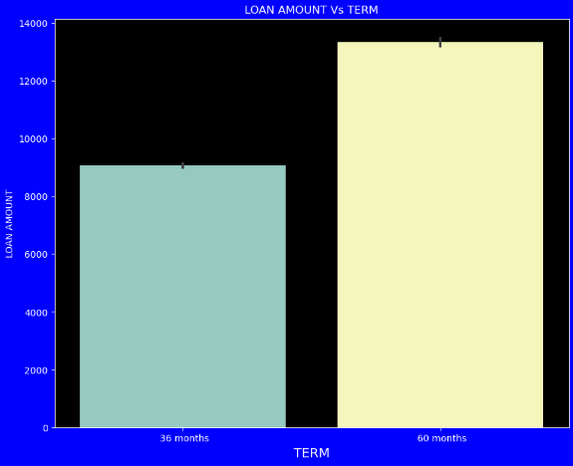
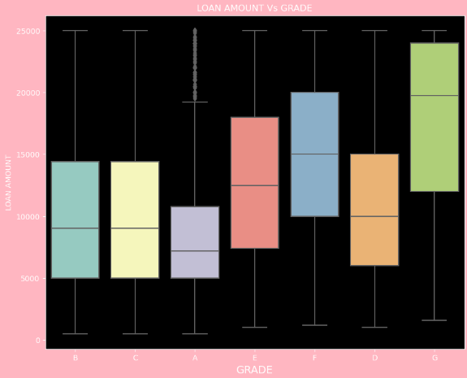
Bi variate Analysis with Two Different components, Part Two
Loan Amount Vs Term
Loan Amount Vs Grade

Slide 20
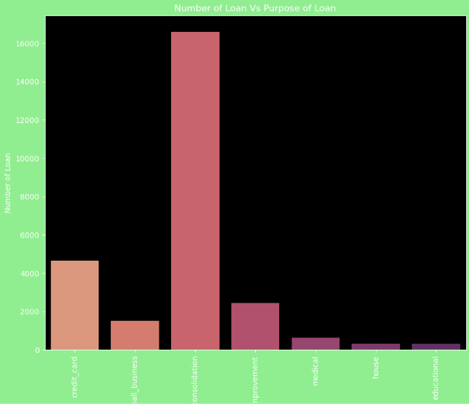
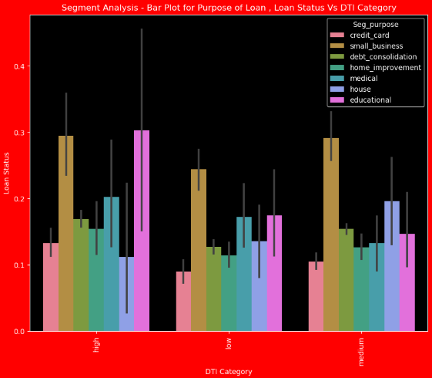
Segmented Analysis
Purpose Vs No of Loans
Purpose Vs DTI

Slide 21
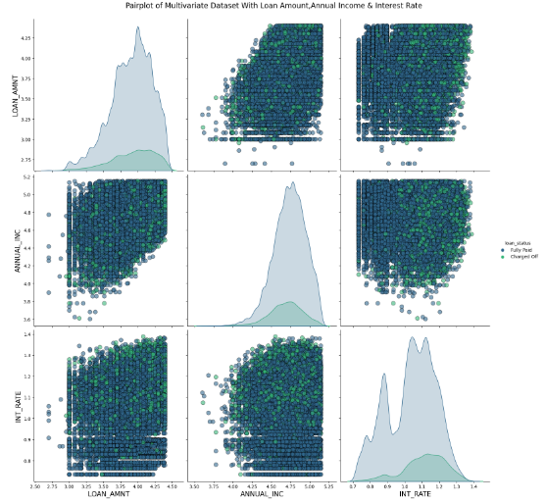
MULTIVARIATE ANALYSIS
Pair plot of Multivariate Dataset with Loan Amount, Annual Income and Interest Rate

Slide 22
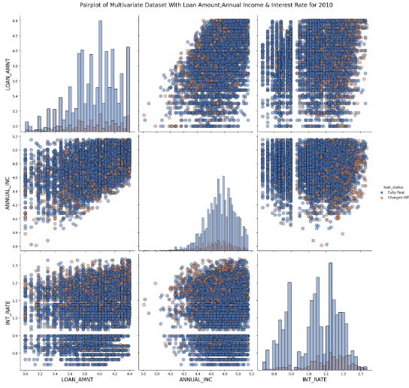
MULTIVARIATE ANALYSIS
Pair plot of Multivariate Dataset with Loan Amount, Annual Income and Interest Rate for 2010

Slide 23
Observations
Multivariate Analysis -2010 Pair plot of Multivariate Dataset With Loan Amount, Annual Income & Interest Rate
A higher charged-off ratio indicates a higher interest rate.
As annual income increases, the loan amount increases slightly.
The interest rate increases with the loan amount, and as it does, there is a significant charge off.
Key Findings:
Amount Categories Distribution
All four amount categories exhibit similar distribution shapes.
Most loan amounts range from 5,000𝑡𝑜15,000.
Annual Income
Annual incomes mostly range from 40,000𝑡𝑜80,000.
Higher annual incomes correlate with:
Larger loans
Higher revolving balances
Higher total payments
Interest Rates
Interest rates primarily fall between 9-14%.
Higher interest rates (20%-25%) result in more charge-offs.
Interest rates decrease with longer employee tenure.
Higher delinquencies and recent credit inquiries are linked to higher interest rates.

Slide 24
Debt Consolidation
Debt consolidation is the most common loan purpose, with many charged-off loans linked to it.
Loans for debt consolidation are the most common.
Loan Amounts and Correlations
Loan amount, funding amount, and funded amount invested are highly correlated.
Larger loans lead to higher total payments.
Loans between 20,000 𝑎𝑛𝑑 25,000 have higher charge-off rates.
Higher loan amounts and interest rates are linked to higher charge-offs.
Longer loan terms (60 months) have higher loan amounts.
More inquiries are associated with larger loan amounts.
Debt-to-Income Ratio (DTI)
High debt-to-income (DTI) ratios are linked to high revolving balances.
Higher DTI loans are more likely to be charged off.
Higher DTI loans have more defaulters, especially in educational and small business loans.
Loan Purpose and Defaults
Small business loans have the highest charge-off rates.
Wedding loans have the least charge-offs.
Small business loans have the highest number of defaulters, followed by educational loans.
House loan defaulters are higher in rented houses.
Small business loan defaulters are higher among those who own homes.
Education and housing loans are fewer.

Slide 25
Loan Grades and Default Risks
Loans with Grade A and Sub Grade A have the lowest charge-off risks.
Grades/Sub Grades F and G have the highest charge-off risks.
Employment and Charge-Offs
Unemployed individuals or those with less than one year of experience are more likely to be charged off.
Geographic and Bankruptcy Insights
States like New York, California, and Florida have high charge-off rates.
Those with public record bankruptcies have higher charge-off percentages.
Interest Rate and Loan Types
Small Business and Debt Consolidation loans charge higher interest rates.
Car loans charge less interest.
Higher charged-off ratios indicate higher interest rates.

Slide 26
Historical and Income Group Insights
Defaulters are more common in years like 2007 and 2009.
Small business loan defaulters span all annual income groups.
Higher-income groups see more house and education loan defaulters.
Higher loan amounts see more defaulters across categories.
All loan defaulters are fewer when interest rates are low and higher when rates are high.
Charge-Off Trends
As annual income increases, loan amounts and interest rates also increase, leading to more charge-offs.

